Slide 1
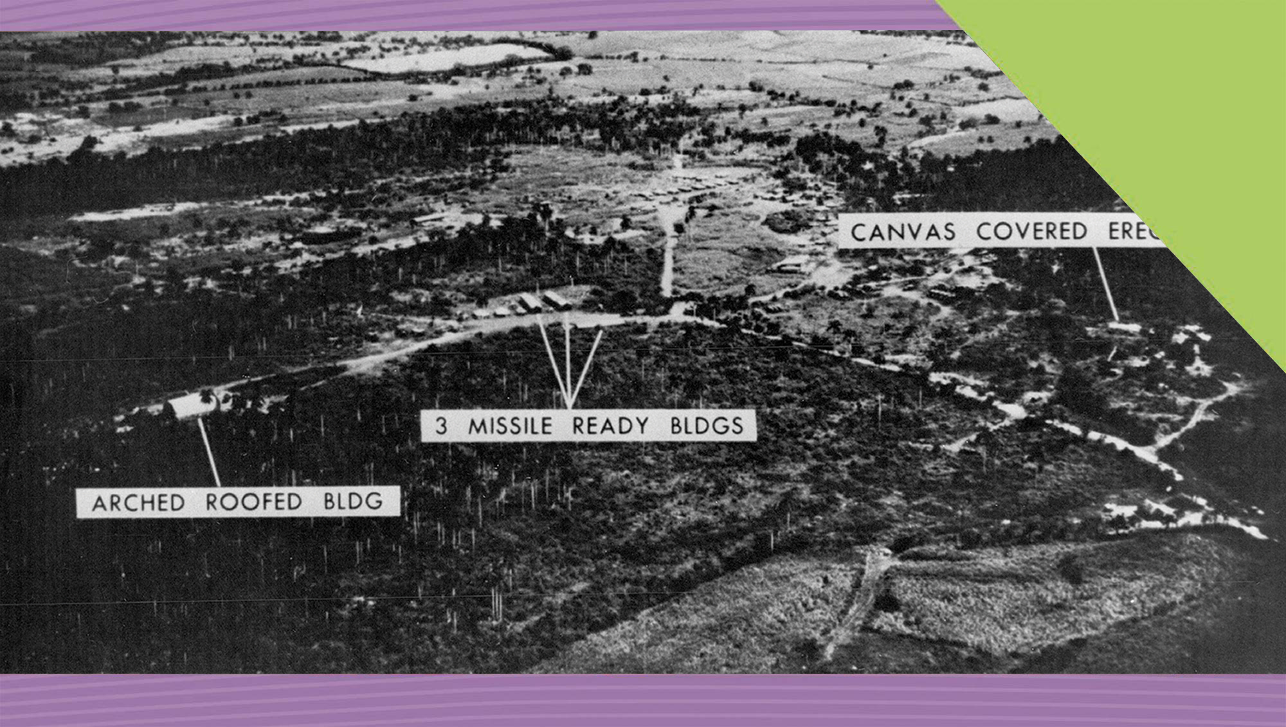
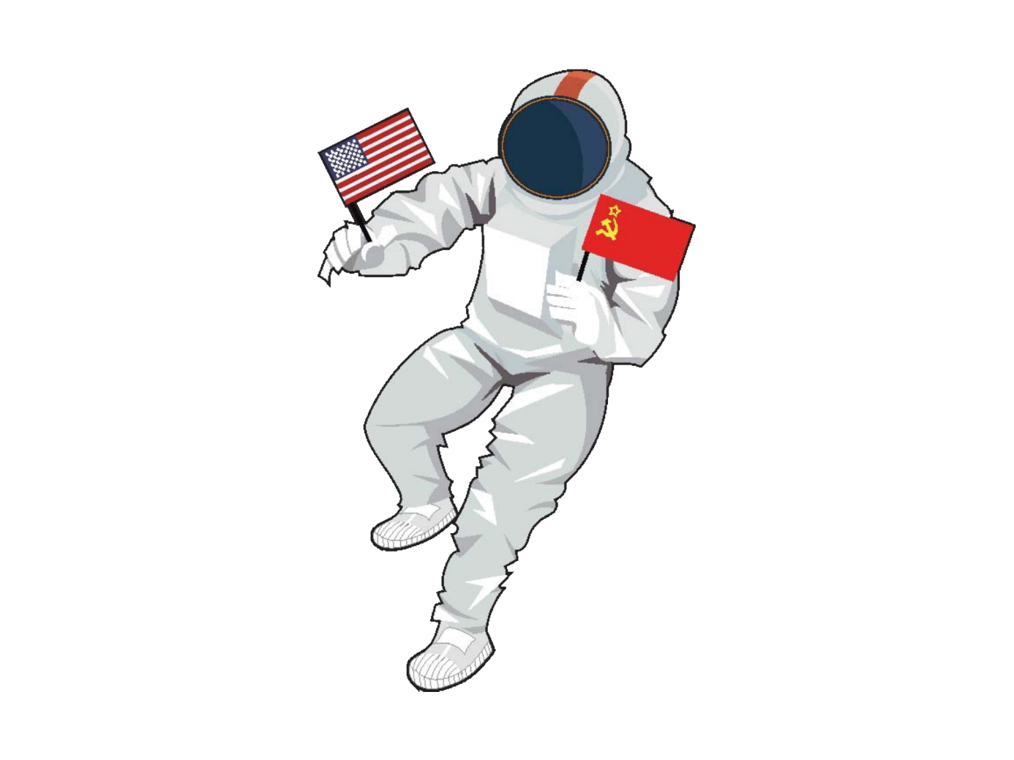

22
The Cold War
Its Importance in International Relations
Making History (2nd Edition)

Slide 2
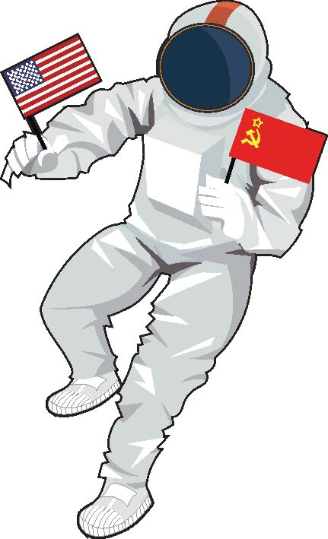
What Will I Learn?
Recognise the importance of the Cold War in international relations
Explore the Nature of History

Slide 3
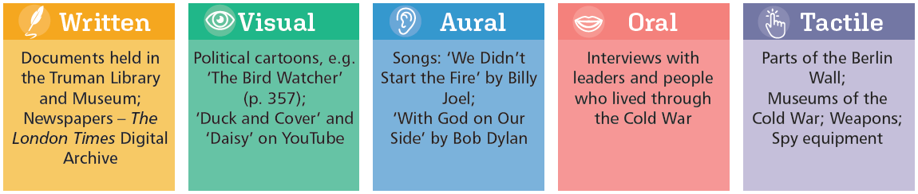
Sources for Studying the Cold War

Slide 4
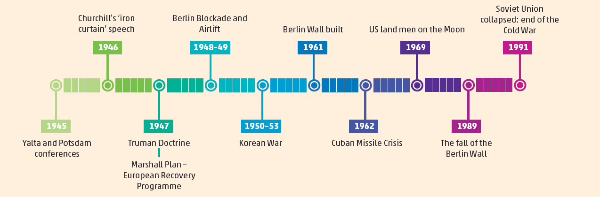
Timeline

Slide 5
Key Words
Arms race | a race between the USA and USSR (Soviet Russia), and their allies to compete for superiority in military arms, often referred to during the Cold War
Atomic and Hydrogen bombs | very destructive bombs based on nuclear energy
Blockade | the sealing off of a place to prevent people or goods from entering or leaving
Capitalism | an economic and political system in which the country's industry and trade are privately owned, and not by the state
Cold War | period of hostility between the USA and its allies and the Soviet Union and its allies which lasted from after the Second World War to the collapse of Communism in the early 1990s
Communism | political belief associated with Soviet Russia that the state (or government) should control industry and agriculture
International relations | the political relations between two or more countries, based on each country’s foreign policy
Nuclear war | a war fought with atomic and hydrogen (nuclear) bombs
Space Race | competition between the USA and the USSR (Soviet Union) to be better at space exploration
Superpowers | USA and USSR after World War II, which were the two most powerful countries in the world
USSR | Union of Soviet Socialist Republics or Soviet Union - union of states under control of Russian Communist Party, established after Russian Revolution in 1917 and lasted until its collapse in 1991

Slide 6
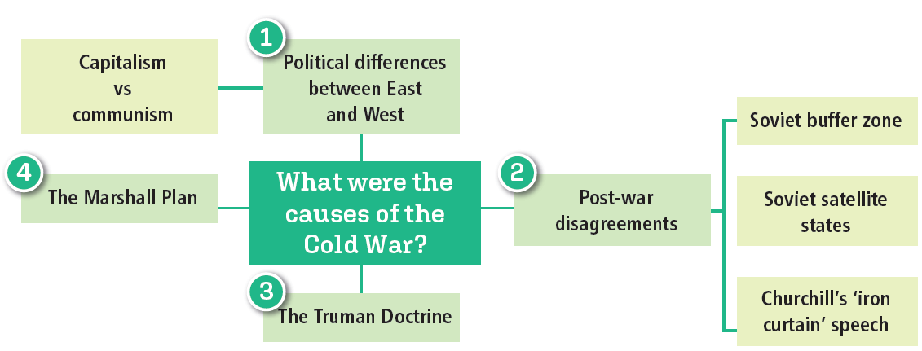
What was the Cold War?
A time of hostility and tension between the 2 superpowers, the USA and the USSR (Union of Soviet Socialist Republics)
A cause of crises and conflicts in international relations (relations between countries)
What caused the Cold War?

Slide 7

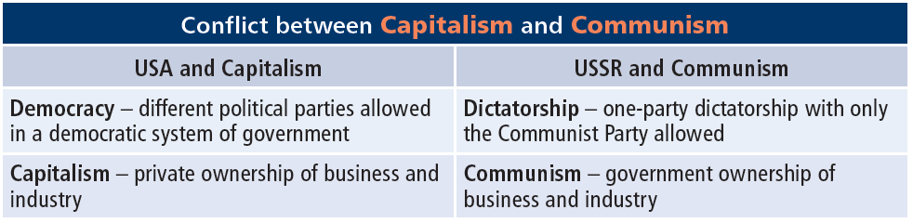
What Caused the Cold War?
Capitalism Vs. Communism – different ways of life
The Cold War was a conflict about which way of life was better and stronger.

Slide 8
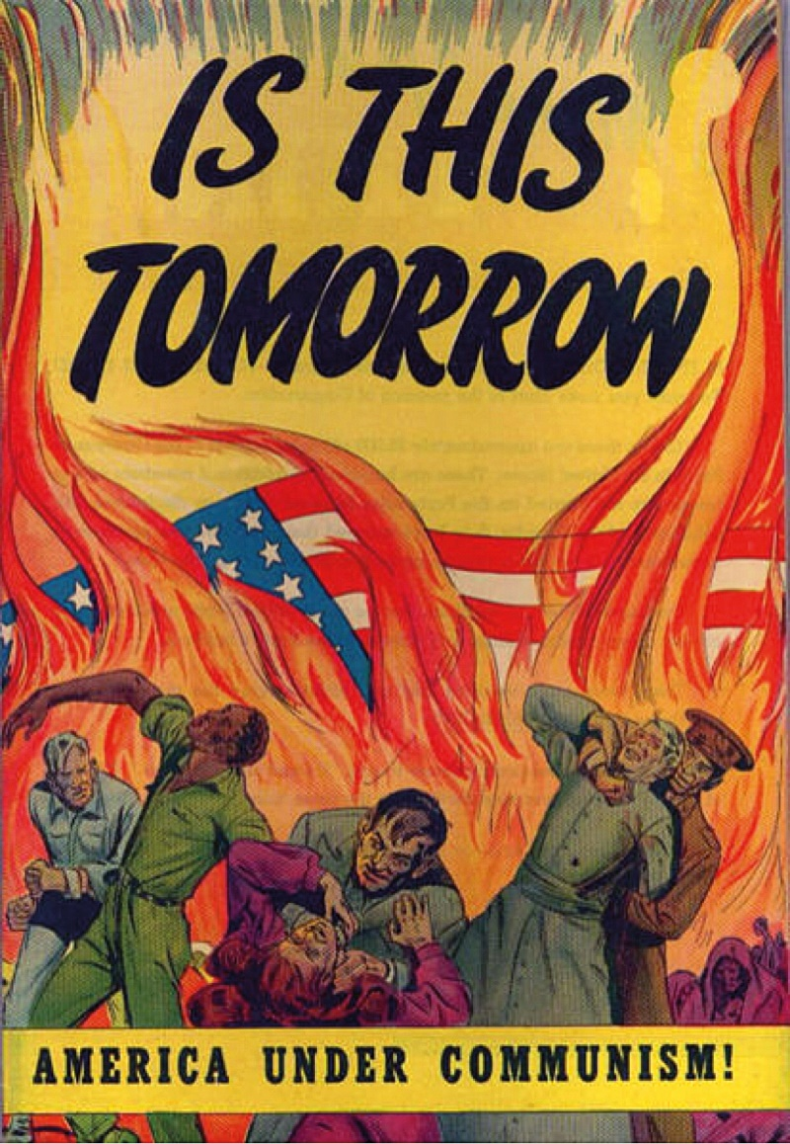
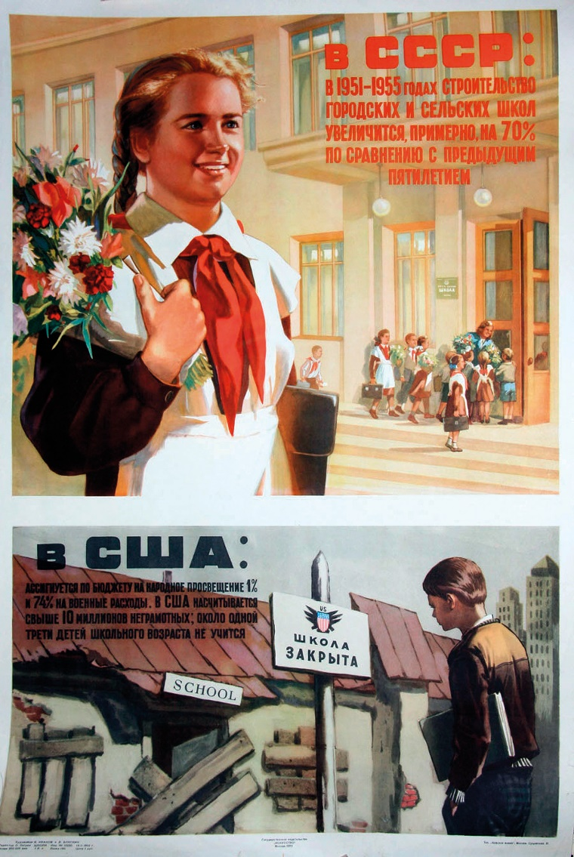
Analysing Sources – Posters of the Cold War
Eye-catching heading – Is this the way America will look under Communism?
In the USSR
Bright, happy colours
Fine building
Happy children going to school
Attractive student in main picture
Colourful flowers
Well dressed
Bright colours
US flag burning in flames
Flames like hell
Arrests
Killing
Conflict between White and Black people
A terrible future
Contrasting the USSR and the USA
In the USA
Dull, dark colours
Sad student, facing away, head down
Ruined, school building
Poverty
Decline
An American poster from the 1950s
A Soviet poster from the 1950s; ‘In the USSR there are many, many new schools, in the USA – schools are being closed all the time.’

Slide 9

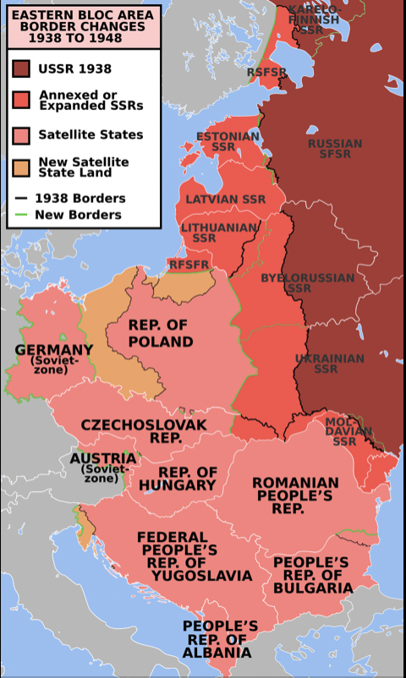

What Caused the Cold War?
Disagreements after World War II
Soviet Union took control of countries in Eastern Europe
Created a buffer zone with the West
Became Soviet satellite states
Churchill said ‘iron curtain’ was drawn across Europe
The Truman Doctrine
President Truman, USA
US would help any governments threatened by communism.

Slide 10


What Caused the Cold War?
The Marshall Plan
US plan to helped economic recovery in Europe after World War II
Stalin (Soviet Union) looked on Truman Doctrine and Marshall Plan as threats against the Soviet Union.
Labelling used on products sent under the Marshall Plan

Slide 11

Assessing Your Learning
What were the superpowers?
Explain international relations.
Define the Cold War.
List three of the causes of the Cold War.
Explain the difference between the Marshall Plan and the Truman Doctrine.

Slide 12
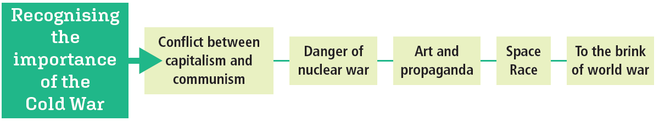
Why was the Cold War Important?

Slide 13
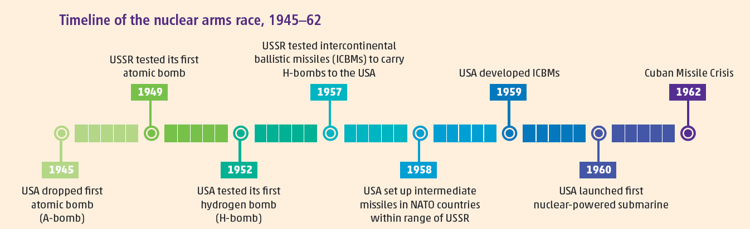
Why was the Cold War Important?
Danger of nuclear war
Arms race between USA and USSR
Hydrogen bombs (H-bombs) and intercontinental ballistic missiles (ICBMs)

Slide 14

Art and Propaganda
Contributed to tensions between both sides
Books, movies and propaganda
Stories about capitalist and communist ways of life

Slide 15
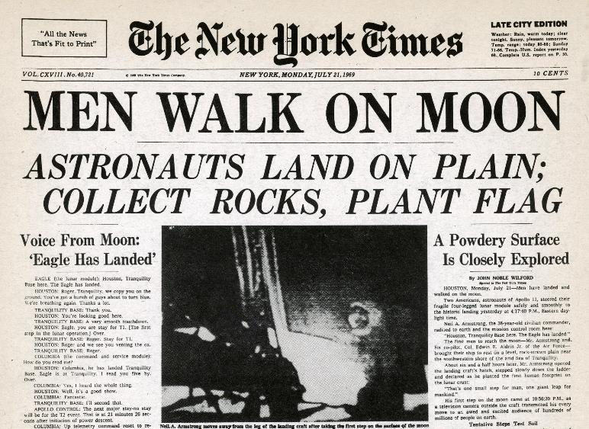
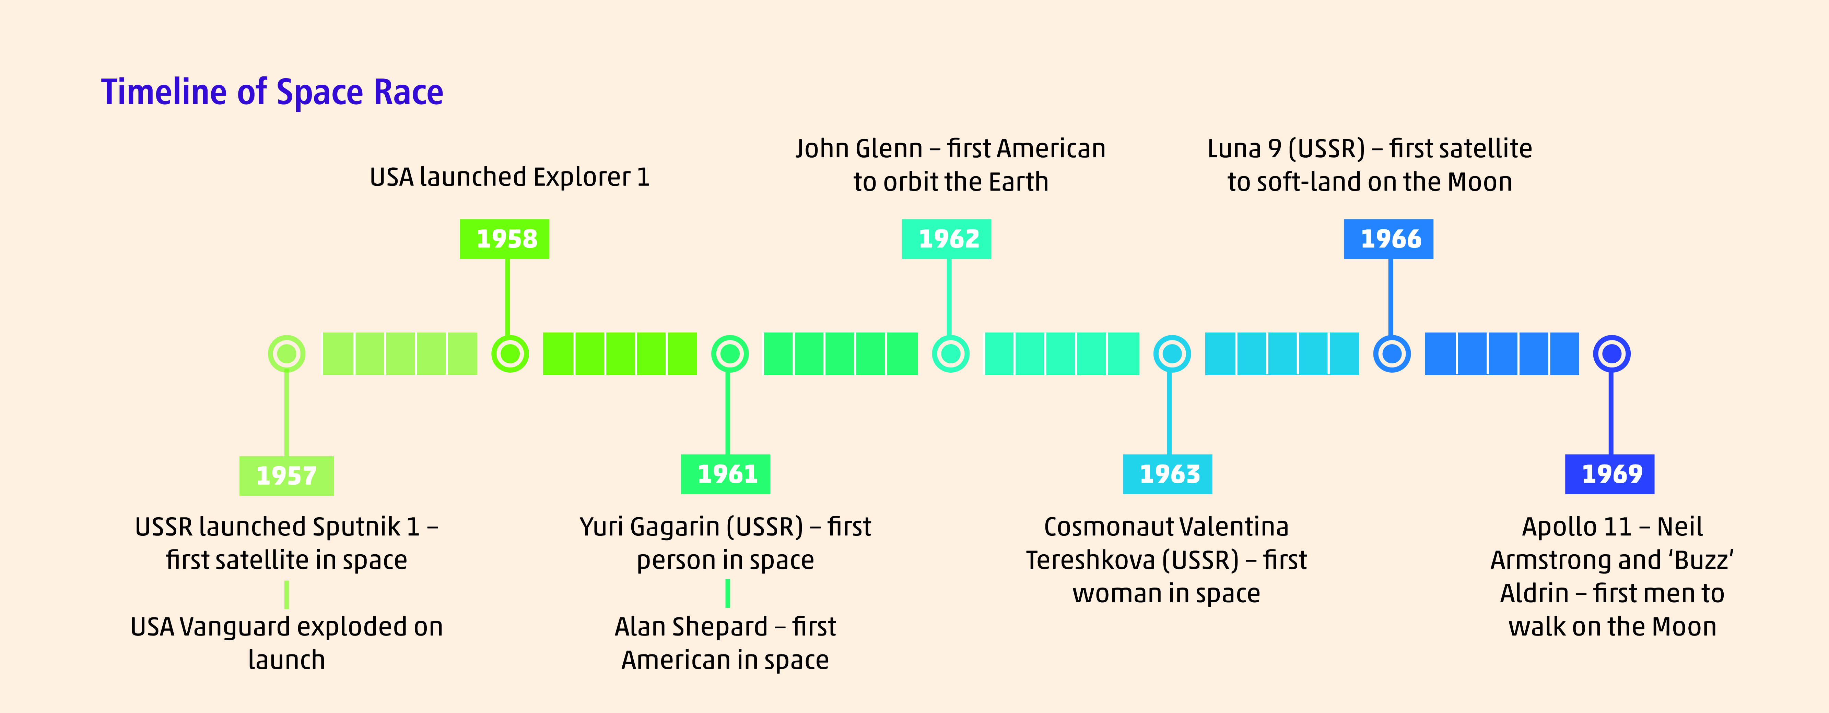
The Space Race

Slide 16
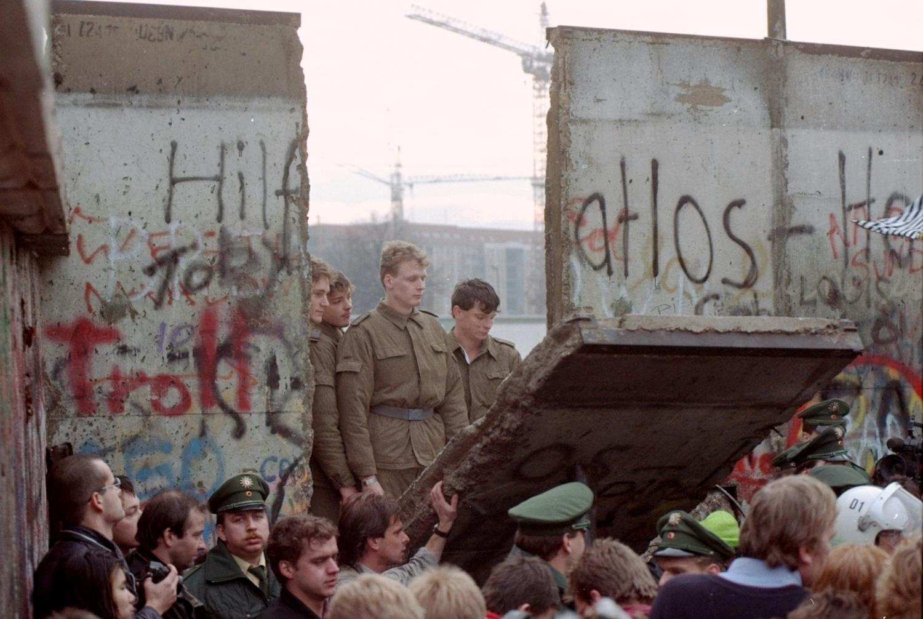
Conflict in the Cold War
The Berlin Blockade
The Korean War
The Cuban Missile Crisis
These conflicts brought the world to the edge of a world war

Slide 17
Assessing Your Learning
Why was the Cold War important?
How did the Cold War influence books and movies?
What was the Space Race?
How did the Cold War influence the Space Race?

Slide 18
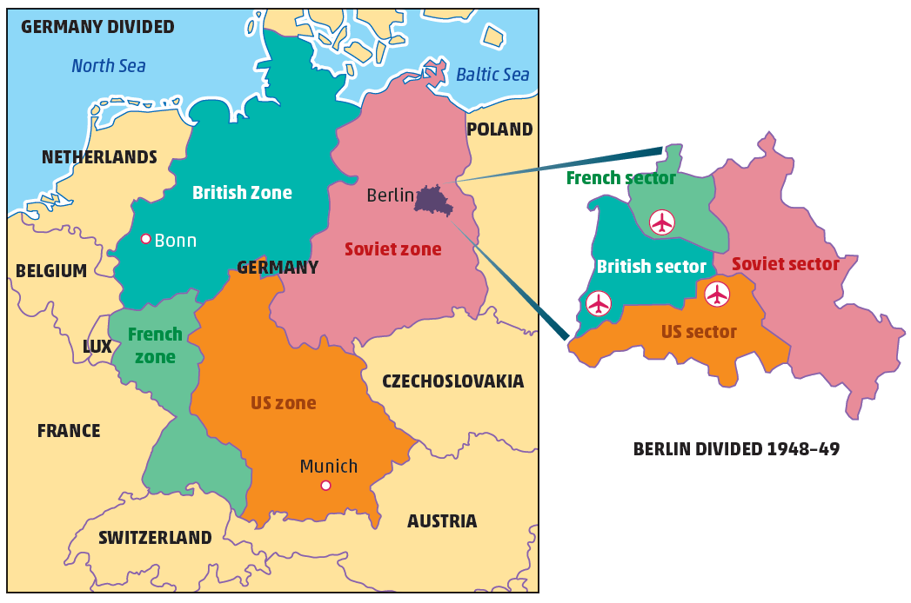
What was the Importance of the Berlin Blockade, 1948–49?
Germany divided into 4 occupied zones after WWII
Berlin divided into 4 sectors

Slide 19
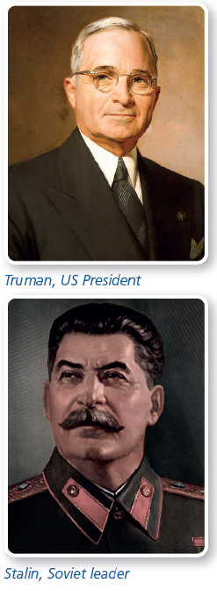
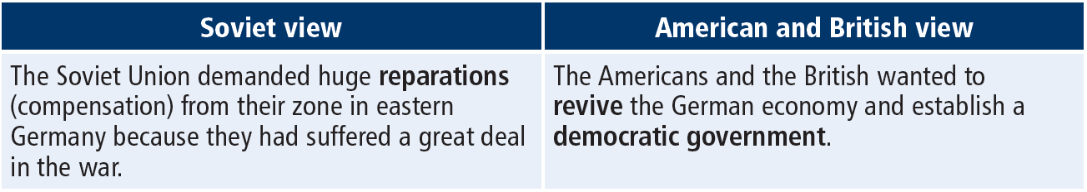
How Should Germany be Treated after the War?

Slide 20
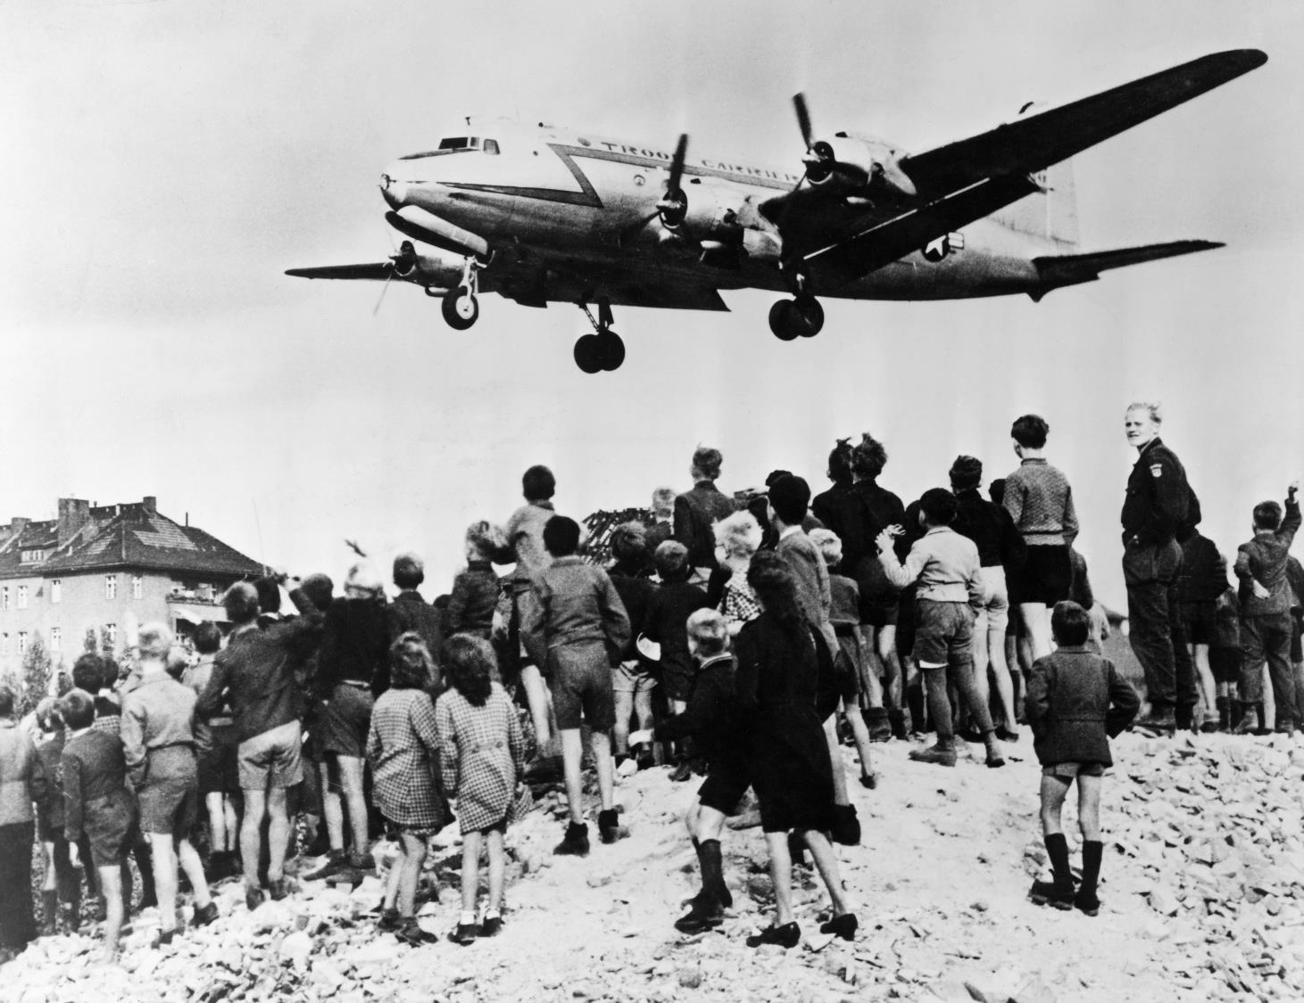
Blockade and Airlift
Americans and British launched a new currency – the Deutschmark
Soviet Union cut off road, rail and canal links to West Berlin
Also cut off power supplies from Soviet zone
Allies use airlift to get supplies to West Berlin
Operation Vittles
Into 3 airports in West Berlin
THE BERLIN AIRLIFT, JUNE 1948 TO MAY 1949
 | USAF | RAF | CIVIL | TOTAL
Flights to Berlin and back | 131,918 | 49,733 | 13,897 | 195,548
Tons flown | 1,101,405 | 255,526 | 79,470 | 1,436,401

Slide 21
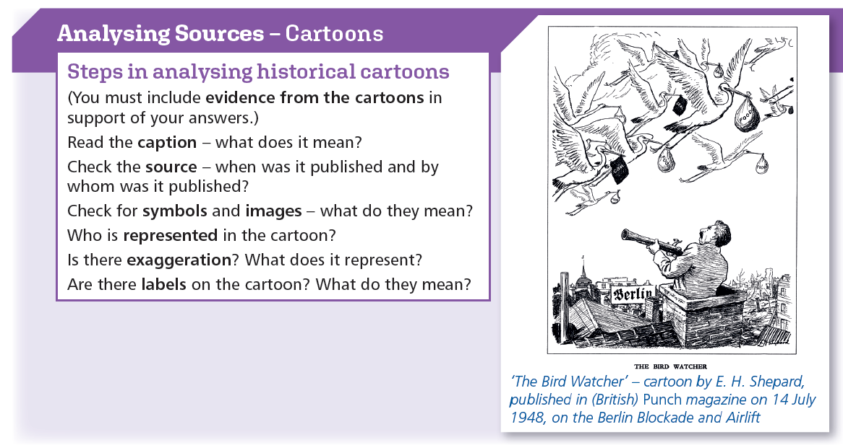

Slide 22
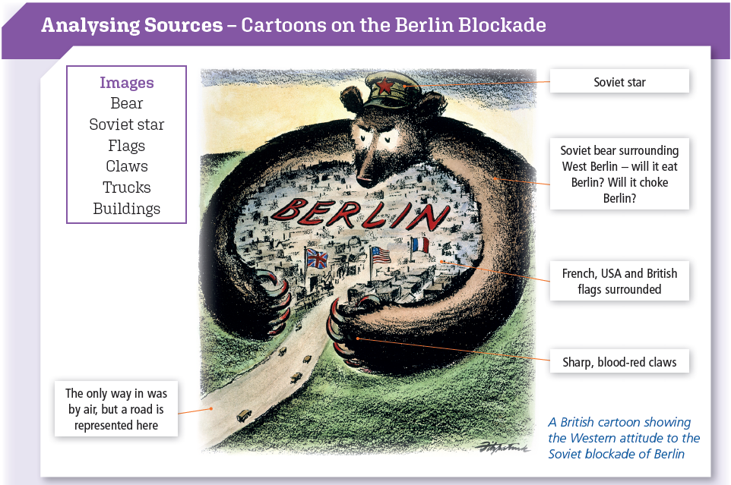

Slide 23
Blockade Lifted
Food rationed
Industry closed down
125,000 lost jobs
Huge meetings to keep up spirits
Stalin realised he could not win
Stalin lifted the blockade, May 1949
Danger of world war ended
Planes were taking off every thirty seconds, soldiers were unloading trucks, the maintenance shops were a beehive of activity, the mess halls and clubs were open. It was a twenty-four hour operation. The commanding officer stood in the control tower with his stop-watch, checking the timing of the planes. To most people it seemed an impossible task to meet the needs of 2,000,000 people by airlift. But, except for water, Berlin was supplied with everything by air.
(Account by US airman, 1948)

Slide 24
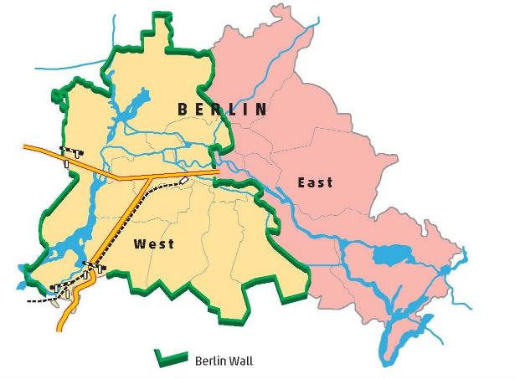
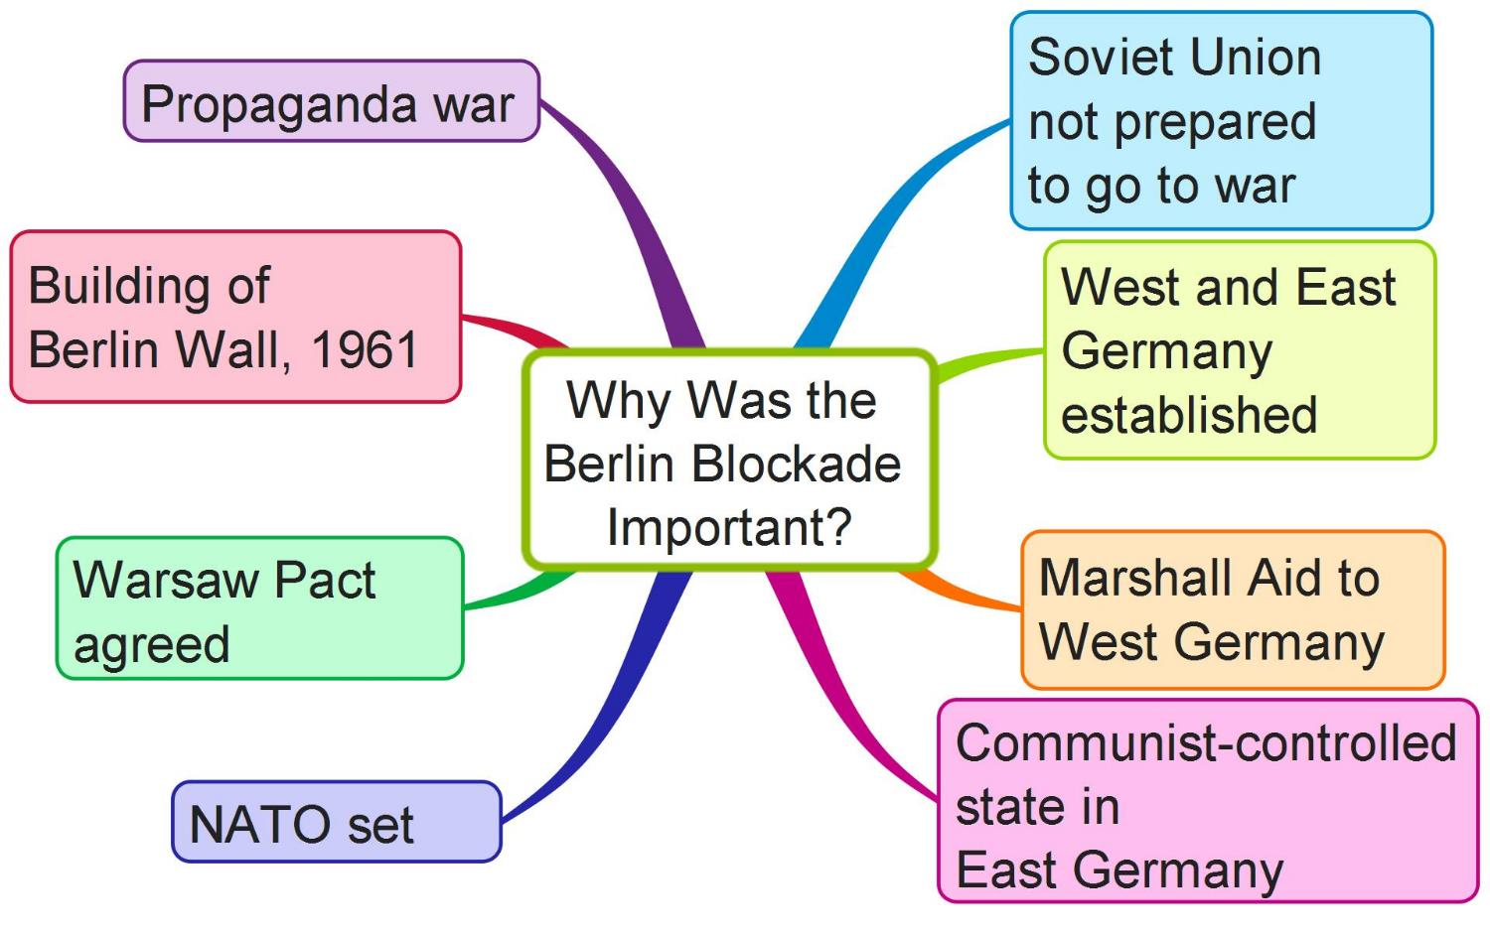
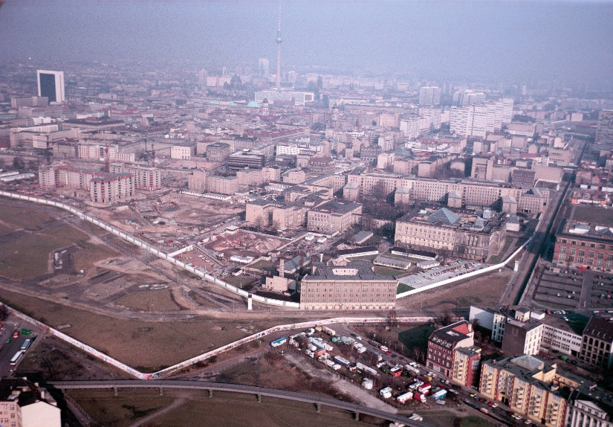
Why was the Berlin Blockade Important?

Slide 25
Assessing Your Learning
How were Germany and Berlin divided after World War II?
How did the USA and the USSR (Soviet Union) disagree over how Germany should be treated after World War II?
How was Berlin blockaded?
How did the USA and its allies try to overcome the blockade?
How did Berlin suffer during the blockade?
Why was the blockade lifted?
How did the Berlin Blockade affect international relations?
Why was the Berlin Wall built?

Slide 26
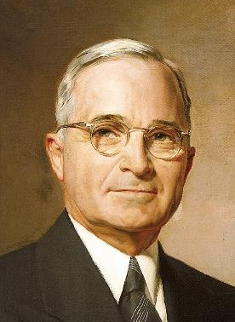
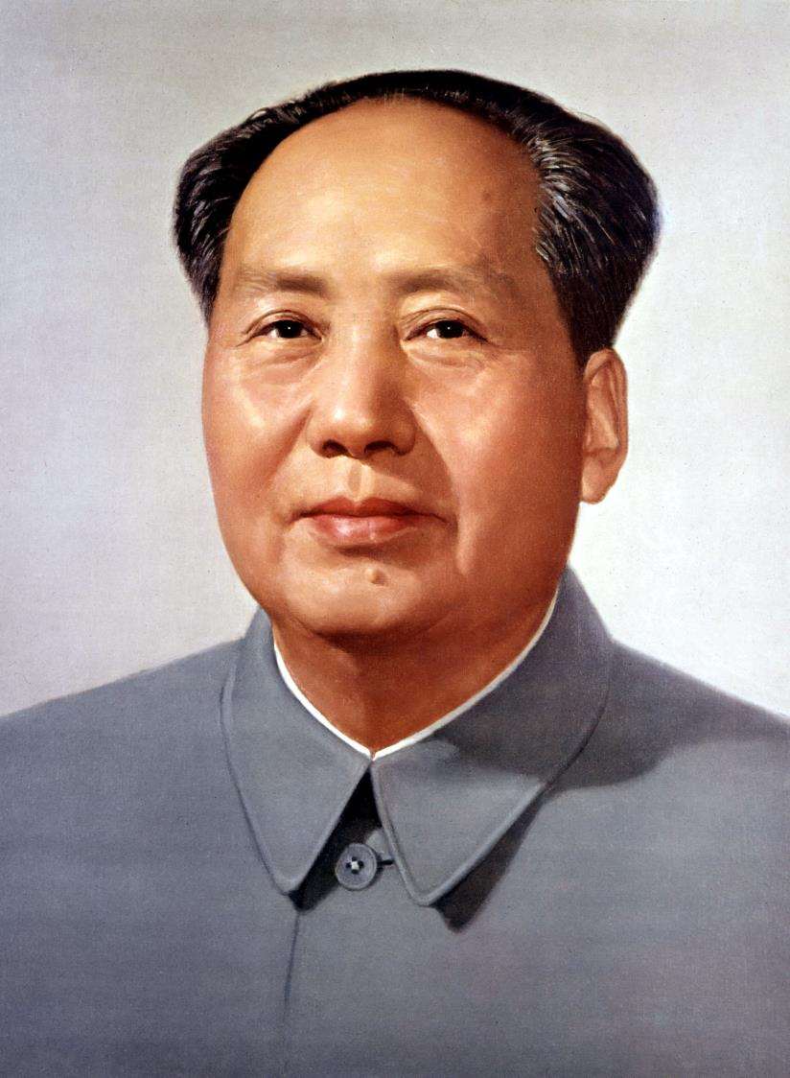
What was the Importance of the Korean War, 1950–53?
Korea divided along 38th parallel after WWII
North Korea supported by Soviet Union
South Korea supported by USA
North Korea invaded South Korea
Harry Truman
Mao Zedong

Slide 27
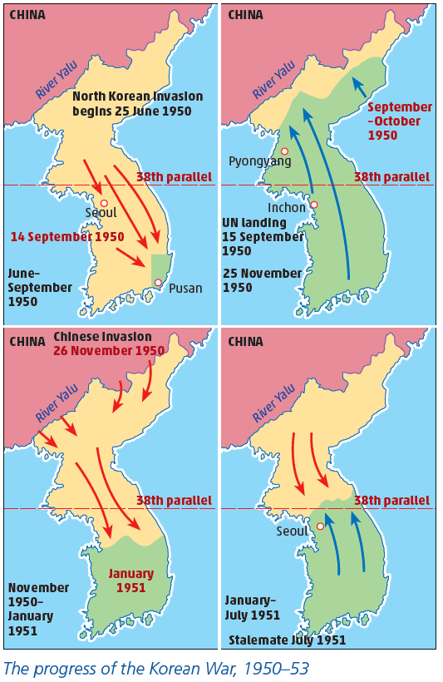
Progress of the War
Truman provided US support
United Nations organised UN forces to support South Korea
Led by MacArthur – advanced towards Chinese border
Mao Zedong provided Chinese troops to back North Korea
MacArthur dismissed
War dragged on
2 new leaders
Eisenhower in US and Khrushchev in Soviet Union made peace
Border around the 38th parallel

Slide 28
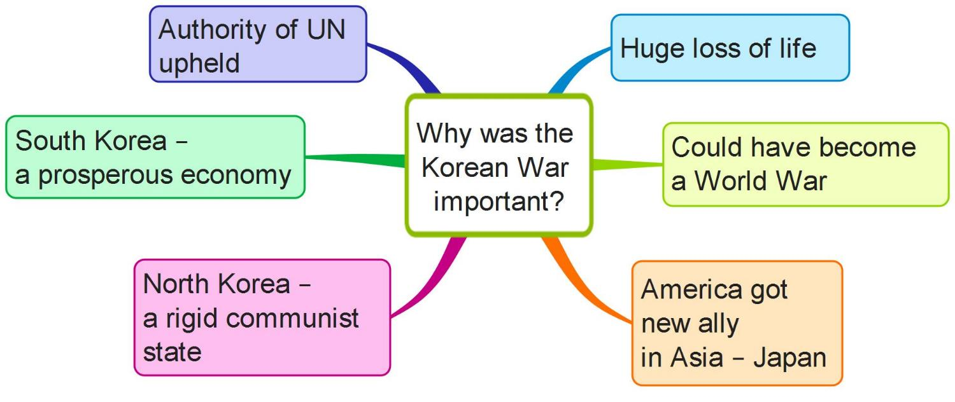
Why was the Korean War Important?

Slide 29
Assessing Your Learning
How was Korea divided after World War II?
How did the Korean War begin?
What countries were involved in the war?
What role did the United Nations play?
What role did the USA play in the Korean War?
How did China get involved in the war?
How did the war end?
How did the Korean War influence international relations?

Slide 30
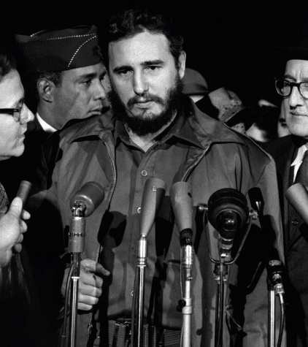
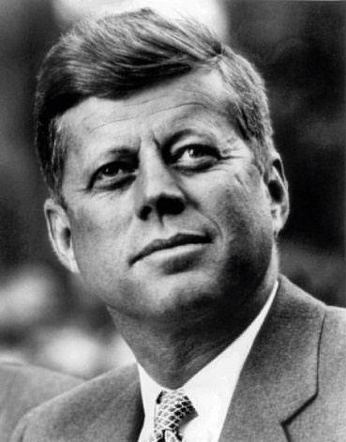
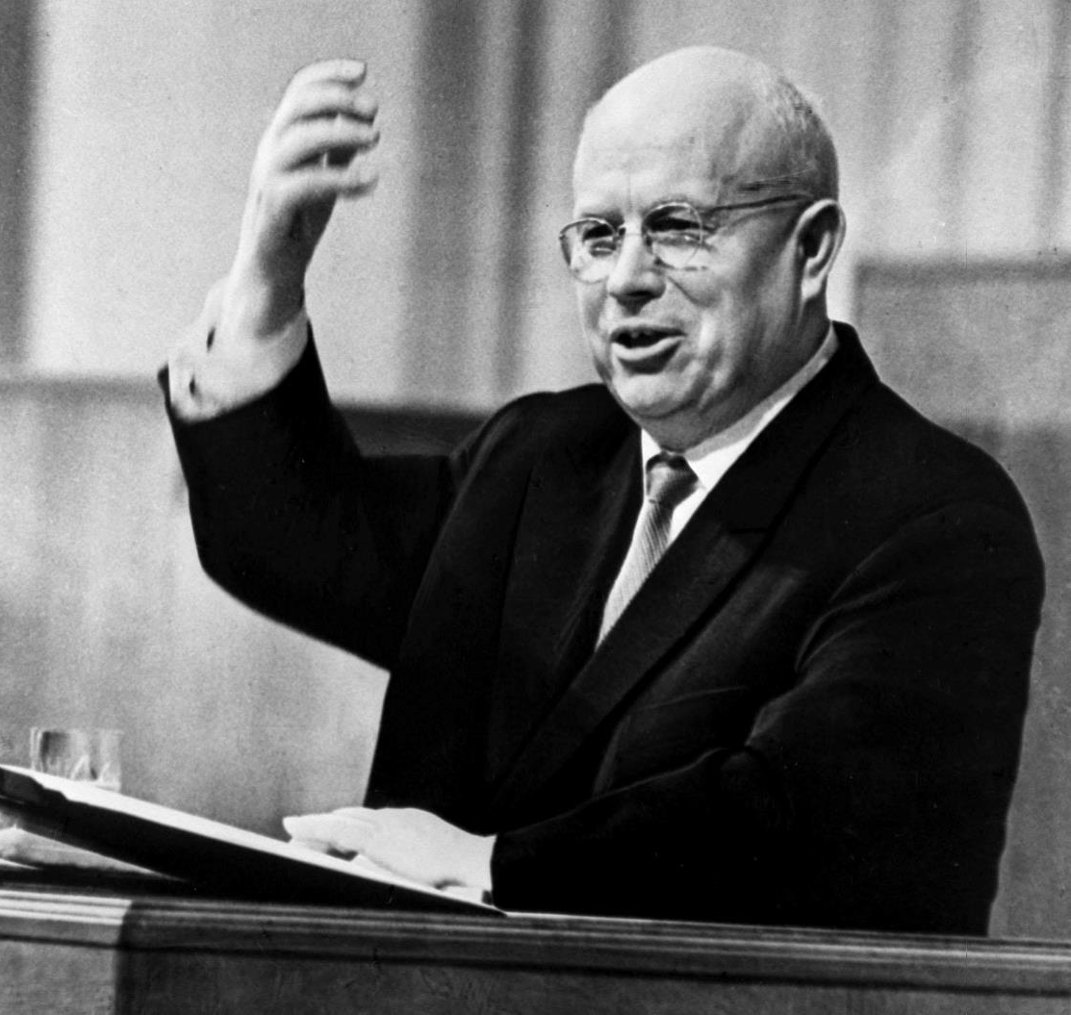
Why was the Cuban Missile Crisis Important?
US supported Batista, dictator of Cuba
Sugar exported to US
Castro, communist leader, took over
Nationalised sugar plantations
Took over US businesses
US refused to buy sugar
Castro got help from Khrushchev, Soviet leader
US organised failed invasion – Bay of Pigs
Soviets constructed missile sites in Cuba
Castro
Kennedy
Khrushchev

Slide 31
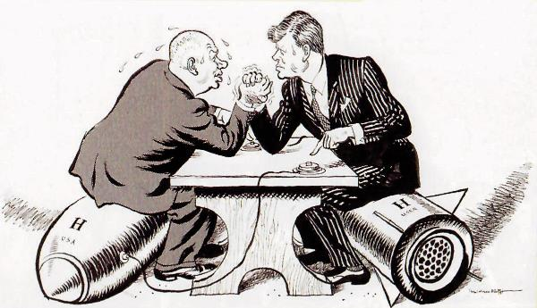
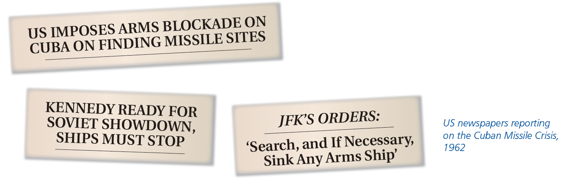
The Progress of the Crisis
Kennedy of US ordered blockade of Cuba
Danger of nuclear war
Soviet ships heading for Cuba
Khrushchev agreed to dismantle missile bases if US agreed not to invade Cuba
Agreement reached

Slide 32
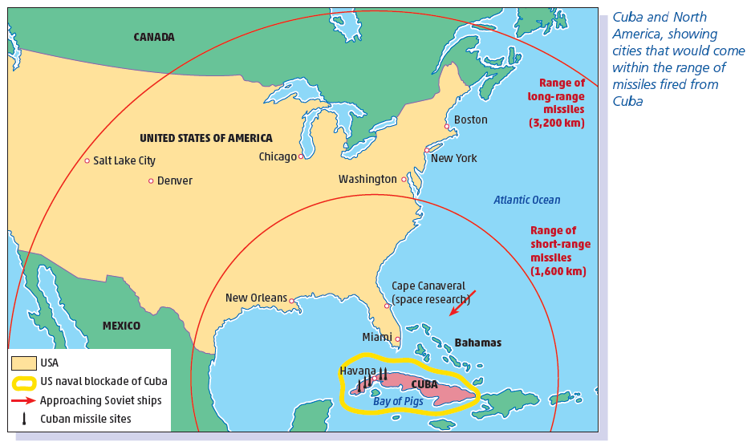
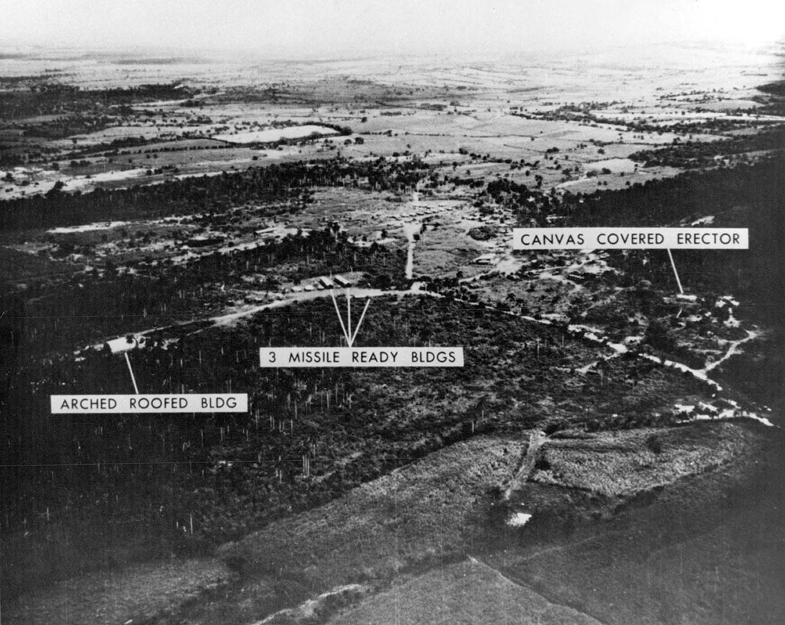
Why did the World Come Very Close to a Nuclear War?
A missile site in Cuba
Cuba and North America, showing cities that would come within the range of missiles fired from Cuba

Slide 33
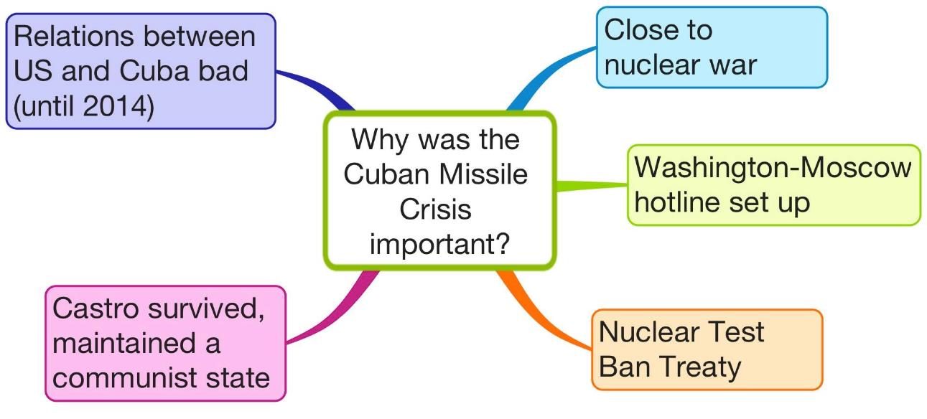
Why was the Cuban Missile Crisis Important?

Slide 34
Assessing Your Learning
How did relations between Castro and the USA worsen?
How did Castro become closer to the USSR (Soviet Union)?
Why did the USA blockade Cuba?
Why could the Cuban Missile Crisis have led to a nuclear war?
What agreement did the USA and the USSR make to end the Cuban Missile Crisis?
How did the Cuban Missile Crisis influence international relations?

Slide 35
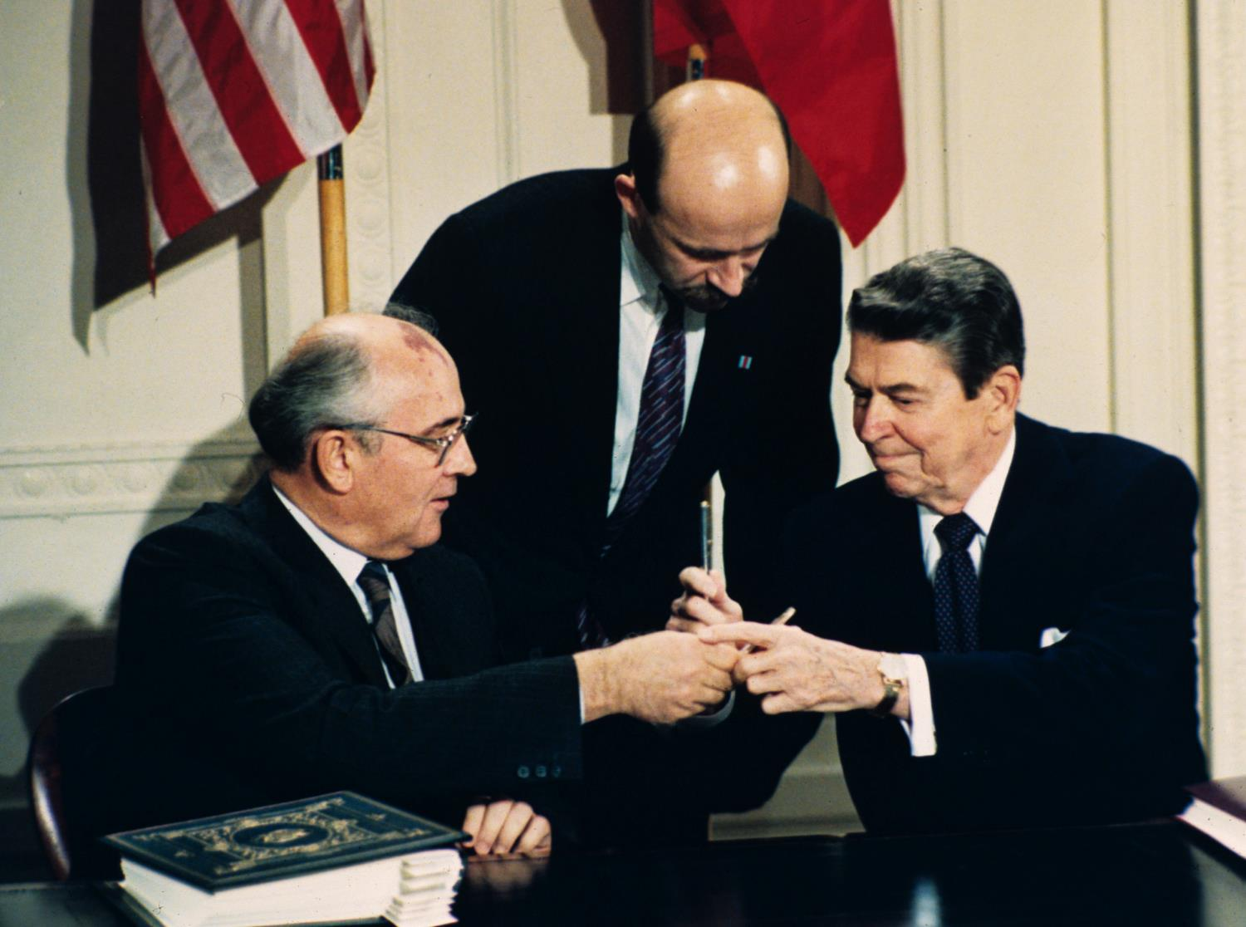
Why was the Collapse of the Soviet Union Important?
Cold War competition between Soviet Union and USA
Soviet economy not strong enough
Soviets involved in war in Afghanistan
Gorbachev, Soviet leader, wanted to reform the Soviet Union
Gorbachev made agreement with Reagan, US President, to stop arms race
Gorbachev promised not to interfere in Eastern European countries
Led to collapse of Communism there
Berlin Wall knocked down
Germany united
Gorbachev, Soviet leader, meeting Reagan, US President
The Fall of the Berlin Wall

Slide 36
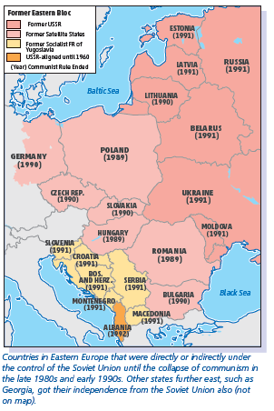
Why was the Collapse of the Soviet Union Important?
Communism collapsed in Soviet Union
The break-up of the Soviet Union
Creation of independent republics
Cold War was at an end

Slide 37
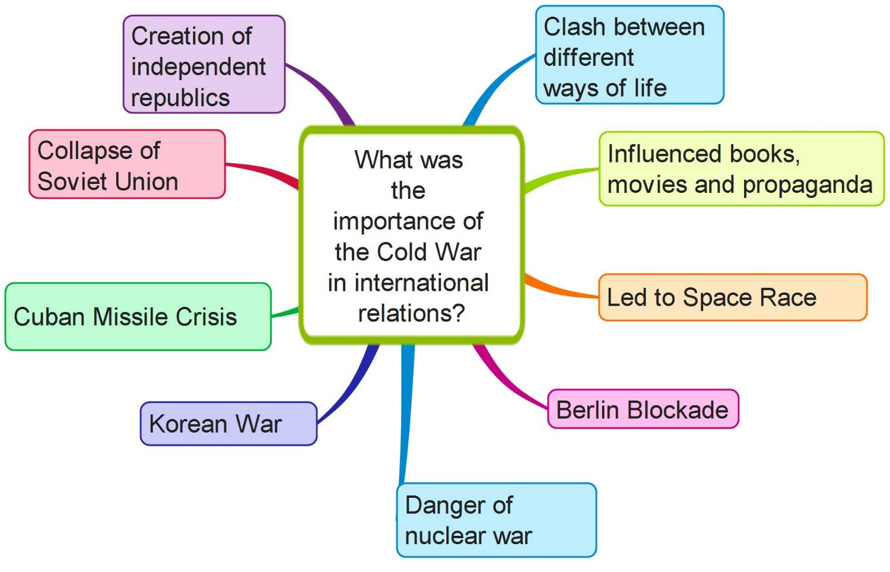

Slide 38
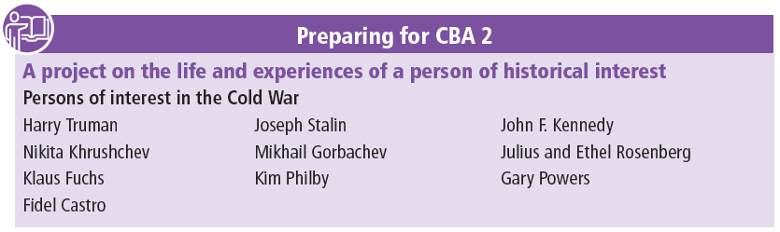
Preparing for CBA 2

Slide 39
